Slide 1
Rice PMO Community of Practice Brief Overview of Project Management
October, 2019

Slide 2
Purpose and Agenda
Purpose:
The purpose of today’s brown bag is to hold an interactive discussion on project management and how project management is used in your organization.
Agenda:
Introductions
Benefits of a Project and a PMO
What is Governance?
Types of Approved Projects
Key Project Management Processes and Tools
Project Management Methodologies
Agile Example: Service Teams
Reporting (monday.com)
A PM Best Practice: Lessons Learned
Future Topics?
Appendix: Draft Prioritization Criteria
Notes:
Kathy

Slide 3
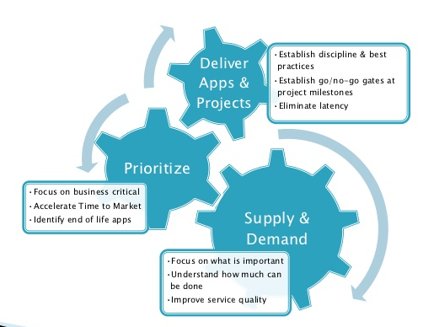
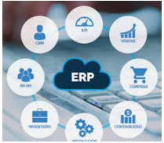
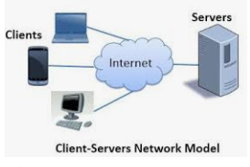
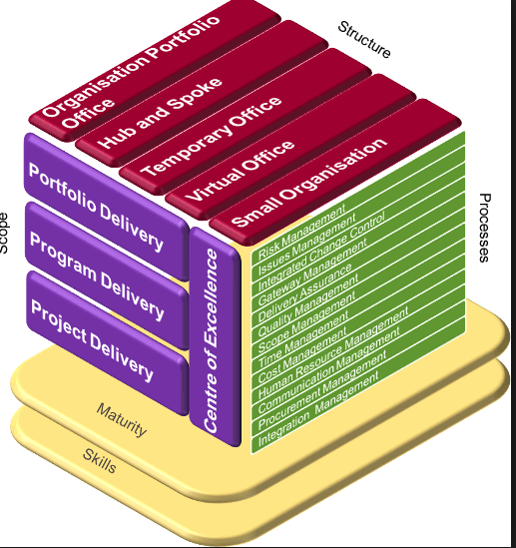
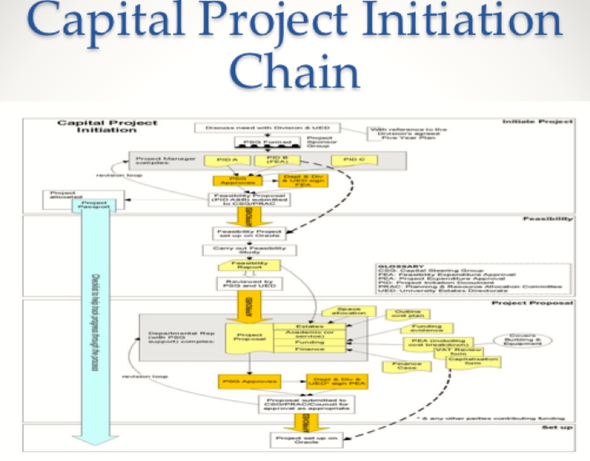
Benefits of a Project and a PMO
Project B
Project C
Project D
Project A
Project E
PMO
Confirm alignment with Rice strategy
Better governance and control
Improve collaboration and team work
Improve resource management
Faster value delivery
Reduce risks (Security, integration, change management, etc.)
Consistent way to manage projects
Standardized methodologies, processes, tools & techniques
Notes:
Eric

Slide 4
What is Governance?
Governance refers to the process of project request, prioritization, and approval as part of a broader portfolio. The starting point is an intake form for projects. OIT leadership is currently reviewing the intake process for opportunities to improvement.
Value of project intake:
Agree with customers on project delivery dates and priorities
Understand dependencies and risks
Examine potential resource impact of projects that are requested
Track projects that are requested over time
Guide the customer in next steps in the process
Rice Evaluation Process
Ideation
Assessment
Decision
Approve for assessment
Progress Reporting
IT Subcommittees
University or Operational Priority
Competitive Advantage
Organizational Readiness
Synergy with ERP
Departments
Approve for implementation
Project request review by governance committee
OIT Strategies
Compliance
Defer
Good Ideas
Notes:
Kathy

Slide 5
Types of Approved Projects
A project is a temporary endeavor designed to produce a unique product, service or result. All projects should go through an assessment and requirements analysis.
An assessment:
Duration may vary
Requires resources from more than one OIT department
Requires engagement from the business
May require consultants
Implementation funding not confirmed
- vs -
An implementation project:
Includes an assessment
Requires more than 3 months of effort
Requires resources from more than one OIT department
Requires engagement from the business
Will result in process change and/or organizational change
Is scoped and funded
Notes:
Eric

Slide 6
Project Management Processes and Tools
Project request is submitted
Approval Statuses
Monday .com Status
Phase
Documentation and activities to complete phase
Waiting for Review
Approved
Deferred
Rejected
Approved
Initiate
Define
Design
Deploy
Close
Develop
Not Started
Started (resources assigned)
In Progress
On Hold
Canceled
Complete
Scope
Approved budget
Milestones and planned deliverables
Identification of risks
Requirements approved
RFP
Assessments:
Security
Ent Arch
Legal
Procurement
Accessibility
Product design
Rollout / communications & change management plan
Update schedule / milestones
Test results
KB article
Help desk training
CAB approval
Training documentation
Training sessions (in person) if applicable
Approval to close / transition to product support
Uploaded documentation
Lessons Learned
Project request
* EA, Security, and Legal assessments should begin when selection has narrowed to 2-3 finalists. Procurement engagement can begin earlier.
Project best practices:
Take notes and store in a centralized location: identify a note-taker or crowd-source
Set your agendas and hold effective meetings
Notes:
Eric

Slide 7
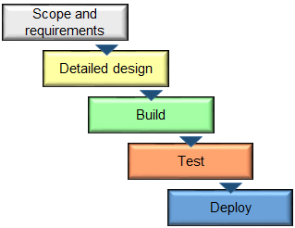
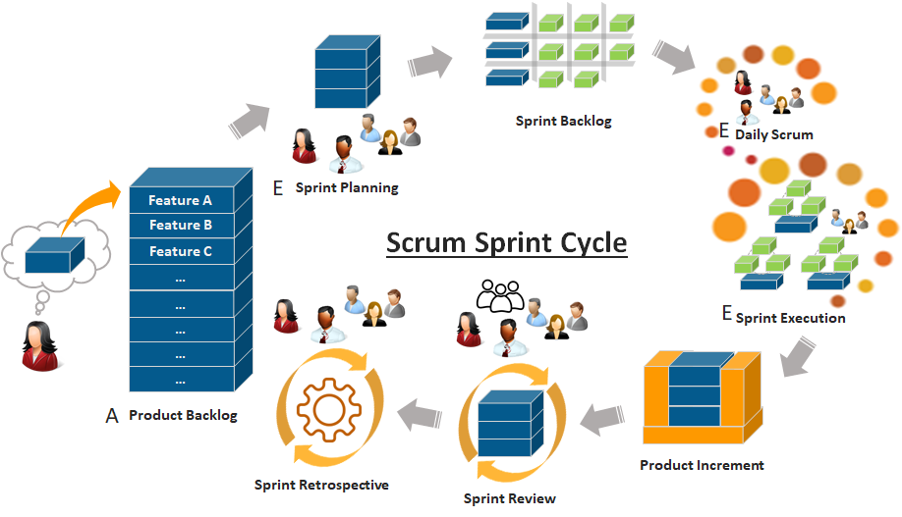
Project Management Methodologies
Even for large projects, many vendors now use a waterfall approach that incorporates Agile concepts, such as speed-to-market, MVP, and iterative cycles.
Waterfall
Traditional design / build / test / deploy model
Released as a finished product
Often used for system development with heavy up-front planning and the end product is well defined
Broader, more distributed team
Agile
Executed as a series of small tasks
Iterative development and release cycle
Minimum Viable Product (MVP)
Often used in software development
Vocabulary: Scrum, Sprint, Scrum Master
Heavy customer involvement and small dedicated team
Notes:
Eric

Slide 8
Agile Example: Service Teams
Characteristics:
Regular (eg quarterly) release cadence
Backlog review
Annual service update
Establish scope of work
Confirm resource availability with managers for resources not on the team
Confirm budget availability
Submit request into queue (backlog) for review and prioritization
Review:
Current activities
New request queue
Reprioritize as needed
Fit with roadmap?
Internal request
Yes
Assign activities to responsible team member – “The Promise”:
Deliverable due date
Solution delivery date (release cycle)
Update activity status / dependency
Create automated reminders to complete work
Communicate quarterly release functionality
Receive CAB approval
Update service architecture model
No
Archive request
Communicate status to customer (provide link)
External request
Responsible
Customer
Service Team Owner / Manager
Assigned Team Member
Notes:
Kathy

Slide 9
Reporting (Monday.com)
Monday.com is a cloud-based task tracking solution that was selected for ease of use. Information is organized into “boards” with three levels of access: 1) member, 2) guest, and 3) view-only.
Key departmental, cross-functional, and strategic projects are now being tracked in the tool for status visibility.
You can see the lasts status on the OIT Staff Confluence page: https://docs.rice.edu/confluence/display/OAS/Project+Updates – the view is automatically updated when the project is updated, so you can always see the latest in-progress projects.
A monthly Monday.com user group has begun meeting to discuss functionality updates and identify opportunities to improve usability of the tool.
Team | Board View
I&O | I&O Board
Admin Systems | Admin Systems
Student Services | Student Services
Learning Environments | Learning Environments
IAM | IAM
CRC | CRC
ISO | ISO
BI | TBD (currently in JIRA)
Notes:
Kathy

Slide 10
A PM Best Practice: Lessons Learned
A “lessons learned” session is an opportunity to improve on your project management skills following a major implementation. This activity works best by gathering all key stakeholders (OIT, customers, vendors) to reflect on each phase of the project and capturing feedback on:
Effectiveness of the project process
Engagement of Rice stakeholder groups
Challenges you faced
What worked and what didn’t work in project execution
Considerations for future organizational initiatives or in additional phases
Comments should be professional and add to the conversation. This is meant to be a learning exercise.
Members of the PMO are happy to help you facilitate a lessons learned session.
Notes:
Eric

Slide 11
Future Topics?
Effective communications / notes / agendas
Notes:
Some ideas:
Scrum / Agile / Data warehouse team lessons learned
Certifications and training(The technology field is ever changing. New methods and technologies are constantly being introduced. Learning new skills is an essential portion of being in the IT field. OIT Staff can spend up to five days a year learning a new skill or exploring a new technology. Examples of how Study Days )
Project Request Form
Agile or Waterfall?
Critical Success Factors for a Project

Slide 12
Appendix: Draft Prioritization Criteria
Priority Definitions
Critical priority
Needed to sustain critical business functionality
Prevents significant degradation or loss of existing service
Needed for regulatory compliance
Addresses security issue
Strategic priority
Related to a Presidential Initiative or other executive priority
Addresses critical functionality gap
Additional funding to complete active project
Enabling project (work that enables higher priority efforts to continue)
Departmental priority
Addresses/resolves high level of customer complaints
Mitigates significant risk by adding fault tolerance, eliminating a point of failure, or adding redundancy to a critical area
Provides enhanced level of service or new service that is now expected as part of basic services
Proactive project
Prevent/identify possible future issues
Nice to do while a related initiative is in progress
Can be deferred but should be done eventually
Criteria | Ranking
Priority | 15 - Critical priority 10 - Strategic priority 5 - Departmental priority 1 - Proactive project
Provides a Competitive Advantage | 10 - Earns revenue / enhance Rice reputation 5 - Bring Rice in line with market / cost avoidance 1 - Cost of doing business
Organizational Readiness | 10 - Leadership commits resources / funding / partnership with another department 5 - Some buy-in but capacity / alignment inconsistent among impacted stakeholders 1 - No cohesive support by impacted stakeholders
Synergy With Proposed New ERP System | 10 – Unlikely to be impacted by ERP or supporting technology for ERP 5 – Compelling exceptions 1 - Potential resource conflict with ERP

