Slide 1
Organization Change Management How to Increase Acceptance and Benefits of Technology/Projects
Notes:
What is change management?
-- migration to production
-- scope change
-- organizational change – what components?

Slide 2
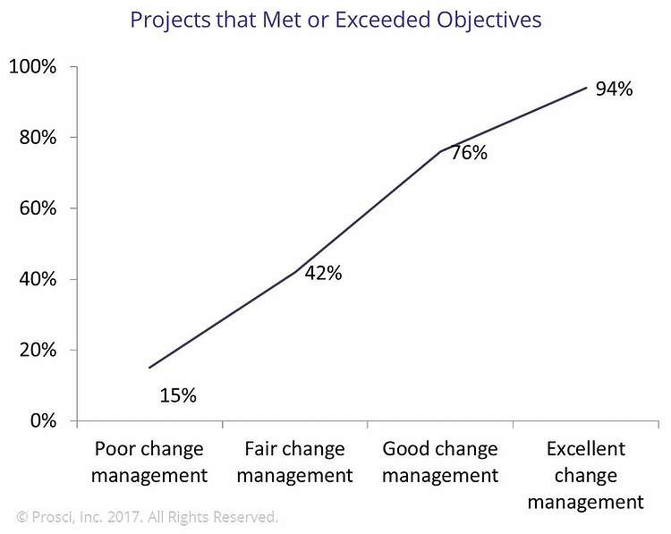
Why Change Management
Increase the likelihood of success
Deliver the benefits
Mitigate risk
Treat employees right
Prosci’s correlation data from over 2,000 data points and ten years shows that initiatives with excellent change management are six times more likely to meet objectives than those with poor change management. By simply moving from “poor” to “fair,” change management increases the likelihood of meeting objectives by three fold. McKinsey data also shows that the ROI captured from excellent change management is significantly more than with poor change management. Change management, when applied effectively on a project, significantly increases the success rate of the effort.
Notes:
-- What are some of the issues, obstacles you’ve run across when rolling out a new technology? Process?
-- Groups too busy?
-- Don’t use it?
-- IT making us do this?
-- The help desk get lots of calls?
-- Didn’t know about it? Example of where some groups at Rice hadn’t heard about the new technology
-- Worse than before?
-- Ever surprise someone with a new change?
Data shows that projects with good change management are more successful and more effective at delivering the benefits
By including the end users in the project, even just through communications, they feel more valued and a part of the change.
Good change management will make them love you and your cool new technologies.

Slide 3
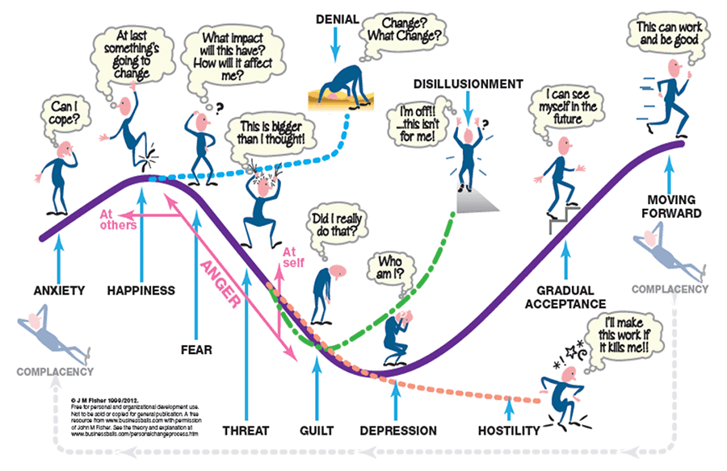
Change Management Models
Notes:
Have you seen individuals upset by having to learn/use/support a new technology?
People actually go through these stages with changes, new technologies.
This is personal for people. In the end, it’s how does this affect them? How does it affect their jobs? How will it make their lives better (or worse).
A lot has to do with perceptions and communication. What is the project telling them? What is their management telling them? What are others around them telling them.
Generally people eventually get on board. Some better than others. But I’ve been on projects where people have left, quit because they don’t want to deal with the change.
I can already see some of these reactions to the new ERP/Oracle Project.

Slide 4
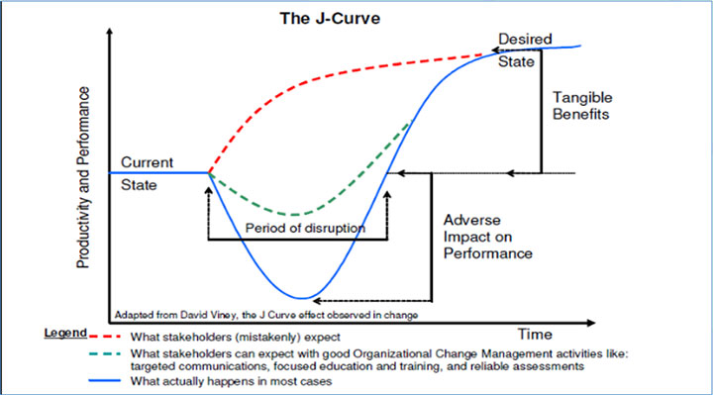
Change Management Models
Notes:
How many have seen this curve before?
Red line is what executive management expects…. Probably not achievable to be more productive at go-live with a new technology.
Blue is what you don’t want to happen. Performance greatly drops because they don’t know how to use the new technologies or perform their jobs with it.
Green is the desired state… what you want to accomplish and can accomplish with good change management. Minimize the learning curve, the impacts on performance. Achieve the benefits faster.

Slide 5
Change Management Framework
Project Definition
Process Design
Define What Is Changing
Manage the Transition
Benefits
Change Guides
Executive Ownership and Sponsorship*
Role Identification and Mapping
Training Design, Development, and Deployment*
Deployment Planning*
Business Case
As-Is Process
Mapping
To-Be Process
Mapping
Recommend
Preferred
Alternative
Organization Design
Stakeholder Analysis*
HR Alignment
Benefits Realization / Value Delivery
Business Impact Assessments
Ongoing Monitoring of Changes
Business Readiness Assessment / Planning
Communications*
Business Engagement
Check Points
Notes:
So, what is good organizational change management and how does it limit dips in performance?
It starts at the beginning of the project and goes past go-live.
It’s important to communicate throughout the project and take checkpoints along the way to measure business (end-user) engagement.
Project Definition/Process Design:
Include key stakeholders in the vision and design of the change.
What are their goals, their objectives.
What would make their jobs/lives better?
What don’t they like about the current processes/technologies?
Define the business case. What is the value they are expecting from the change, the new technologies?
Important to make them feel like owners of the change, get their buy-in. This is a critical step.

Slide 6
Define the Change
Define What is Changing:
Define What Is Changing
Manage the Transition
Benefits
The first step in an effective change program is to clearly define the changes.
A thorough understanding of the changes coming to the organization helps to scope the type and magnitude of interventions required.
Defining the changes also helps to build ownership for the program among key stakeholders.
Change Guides
Executive Ownership and Sponsorship*
Role Identification and Mapping
Training Design, Development, and Deployment*
Deployment Planning*
Organization Design
Stakeholder Analysis*
HR Alignment
Benefits Realization / Value Delivery
Business Impact Assessments
Ongoing Monitoring of Changes
Business Readiness Assessment / Planning
Communications*
Business Engagement
Check Points
Components:
Organization Design/Alignment - Outlines how the organization structure, jobs, teams and roles need to change to enable the future business processes (for both the business and IT).
Stakeholder Analysis - Captures characteristics of the impacted organization such as group size, location, and buy-in criticality.
HR Alignment – Identifies HR activities that may need to be undertaken as a result of the system, process, and organization changes.
Business Impact Assessment - Identifies how the changes from the “As-Is" processes, systems, and structures to the “To-Be" processes, systems, and structures impact specific organizations and roles.
Notes:
At the beginning of the project, good change management starts with:
Stakeholder Analysis:
Defining who will be impacted by the project, the new technology? Who are the key stakeholders, organizations, individuals and what are their roles, jobs… personas?
Are they advocates of change? Do they need to be?
Who will most resist the change? How will you get them on board?
Change Impact Analysis (Business Impact Analysis):
How will the new technology impact them? Their roles?
-- Will they need to reorganize? New Organization? Org Changes? > Org Design
-- Will their roles change – do less, do more?
-- Will roles go away or new roles be needed? >HR Alignment
-- Will they need to learn new skills?

Slide 7
Monitor the Progress
Ongoing Monitoring of Changes:
Define What Is Changing
Manage the Transition
Benefits
Change Guides
Executive Ownership and Sponsorship*
Role Identification and Mapping
Training Design, Development, and Deployment*
Deployment Planning*
Change Management is an iterative process that must be managed throughout the life of the project.
The goal is to recognize the need for course corrections before go-live, not after.
These steps build ownership in the solution throughout the organization.
Organization Design
Stakeholder Analysis*
HR Alignment
Benefits Realization / Value Delivery
Business Impact Assessments
Ongoing Monitoring of Changes
Business Readiness Assessment / Planning
Communications*
Business Engagement
Check Points
Components:
Business Readiness Assessment / Planning – Determines the readiness levels of business users with regard to upcoming changes; assessments uncover readiness gaps. If gaps are identified through the readiness assessments, actions plans to close the gaps should be created and implemented prior to go-live.
Communications - Outlines the key messages that need to be communicated throughout the project.
Business Engagement - Defines the activities needed to bring the impacted audience to the required level of buy-in prior to go-live.
Notes:
Communications and Business Engagement is generally an afterthought but it is probably the most important part of Organizational Change Management and project success.
Based upon the Stakeholder Analysis, put together targeted communications to the various stakeholders.
Put together a Communications Plan.
What communications, engagement activities are needed and when?
What types of communication vehicles are there at Rice?
Group emails
Admin Forums
IT Steering Committee Meetings
Townhalls – University, Departments, etc.
Faculty Committees/Council
Business Engagement: -- Part of project definition, process design
-- Steering Committees, Executive Committees for Projects
-- Project Roadshows – what is changing, how will it impact them, what is better? Sales and Marketing
-- How gauge? Focus groups. Surveys. Informal inquiries. Checkpoints.

Slide 8
Manage the Transition
Define What Is Changing
Manage the Transition
Benefits
Manage the Transition:
Change Guides
Executive Ownership and Sponsorship*
Role Identification and Mapping
Training Design, Development, and Deployment*
Deployment Planning*
Once the changes are defined, specific action is required to move the organization from the “As-Is” to the “To-Be” state.
These tasks help enable the organization with the skills to work in the future environment.
These tasks also help build ownership for the program among the user base.
Organization Design
Stakeholder Analysis*
HR Alignment
Benefits Realization / Value Delivery
Business Impact Assessments
Ongoing Monitoring of Changes
Business Readiness Assessment / Planning
Communications*
Business Engagement
Check Points
Components:
Change Guides – Package the impacts gathered through the Business Impact Assessments and communicate to impacted users prior to their formal training to ensure they are fully prepared and oriented to the major changes.
Executive Ownership and Sponsorship – Identifies activities and behaviors that executive leadership must engage in to provide navigation towards the future environment, lead the organization in that direction, and build a sense of ownership over time.
Role Identification and Mapping - Groups the organization into targeted roles for change management interventions.
Training Design, Development, and Deployment - Defines how the project will build the necessary process and system capability in the impacted user groups through performance support (job aids, coaching, knowledge systems, practice scenarios, and simulations).
Deployment Planning – Aligns agreement around all relevant pieces of the deployment which need to be considered, defined, resolved, or require action to enable implementation.
Notes:
Once you’ve identified the change impacts, how do you get them from where they are to where they need to be? Manage the Transition.
For the various roles, define and develop:
-- New skills training
-- New system training (hands on)
-- Process training with Change Guides… how are the processes changing.. Can use these in the Roadshows
-- Map roles to training, define courses and who needs to attend
-- Put together a training plan/curriculum
Design the new organization, changes, positions. Work with HR as needed to define them, create them, etc.
Have business sponsors, executive sponsors champion the change, communicate to their organizations, provide incentives, etc.
Put together a deployment plan with timing, responsibilities, go-live activities
Provide training
Communications for go-live and training are key

Slide 9
Focus on Benefits Realization
Benefits:
Define What Is Changing
Manage the Transition
Benefits
Ensuring that the business value outlined in the business case is the key measure of a project’s success.
Value delivery is focused on point solutions that deliver best practice post implementation to improve absorption within the business, or ensure that processes or procedures are adhered to in the most effective and efficient manner.
Change Guides
Executive Ownership and Sponsorship*
Role Identification and Mapping
Training Design, Development, and Deployment*
Deployment Planning*
Organization Design
Stakeholder Analysis*
HR Alignment
Benefits Realization / Value Delivery
Business Impact Assessments
Ongoing Monitoring of Changes
Business Readiness Assessment / Planning
Communications*
Business Engagement
Check Points
Components:
Benefits Realization/Value Delivery - Defines and manages the activities to ensure achievement of the business case after go-live.
Notes:
Throughout the project, stay focused on the value to be achieved, the benefits to be realized.
Manage communications and scope to keep the focus on the benefits case.
Set business targets for go-live and months following. Compare to baseline targets. Measure performance.
How did you impact the J-Curve?
Monitor. Plan to make adjustments, provide additional training, etc.
Post go-live communications, celebration.

