Slide 1
Rice PMO Knowledge Management Brief Discussion of Knowledge Management
6/4/2019

Slide 2
Purpose and Agenda
Purpose:
The purpose of today’s brown bag is to hold an interactive discussion on Knowledge Management (KM) and how we might consider improving KM at Rice.
Agenda:
Introductions
What is Knowledge Management?
What are current tools and techniques used at Rice?
What should we consider in terms of managing and improving KM?
Notes:
Kathy

Slide 3
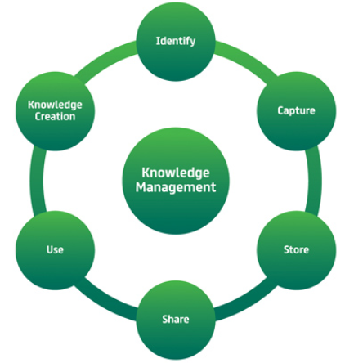
What is Knowledge Management?
Wikipedia – KM from an organization’s perspective - KM is the process of creating, sharing, using and managing the knowledge and information of an organization. It refers to a multidisciplinary approach to achieving organizational objectives by making the best use of knowledge.
PMI – KM from a project perspective – KM is commonly split into “explicit” (knowledge that can be readily codified using words, pictures, numbers) and “tacit” (knowledge that is personal and difficult to express, such as insights, experience, “know-how”). KM is concerned with managing both for two purposes: reusing existing knowledge and creating new knowledge. The key activities that underpin both are knowledge sharing and knowledge integration.

Slide 4
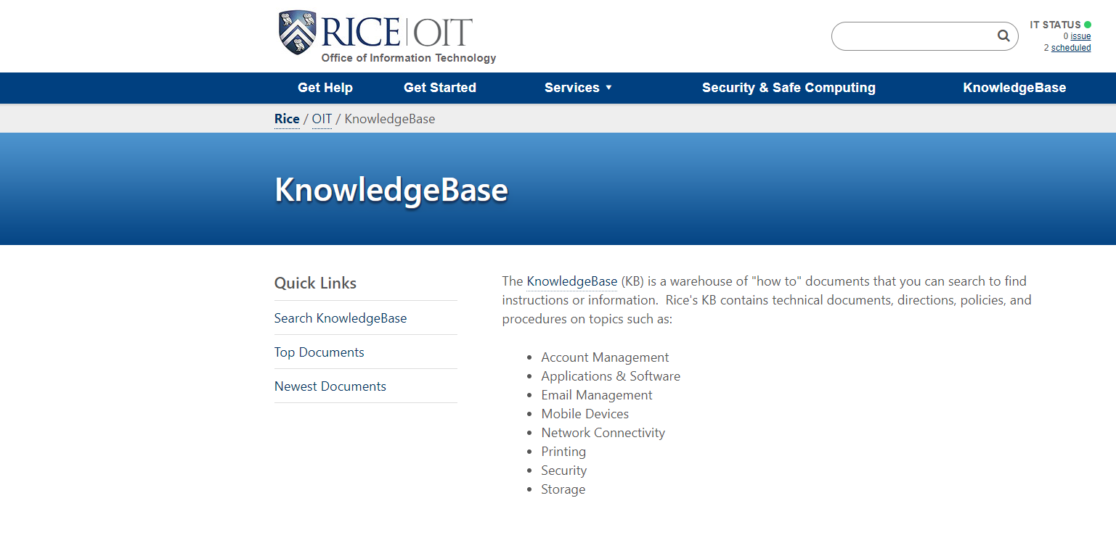
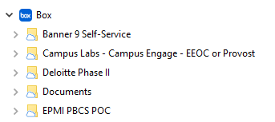
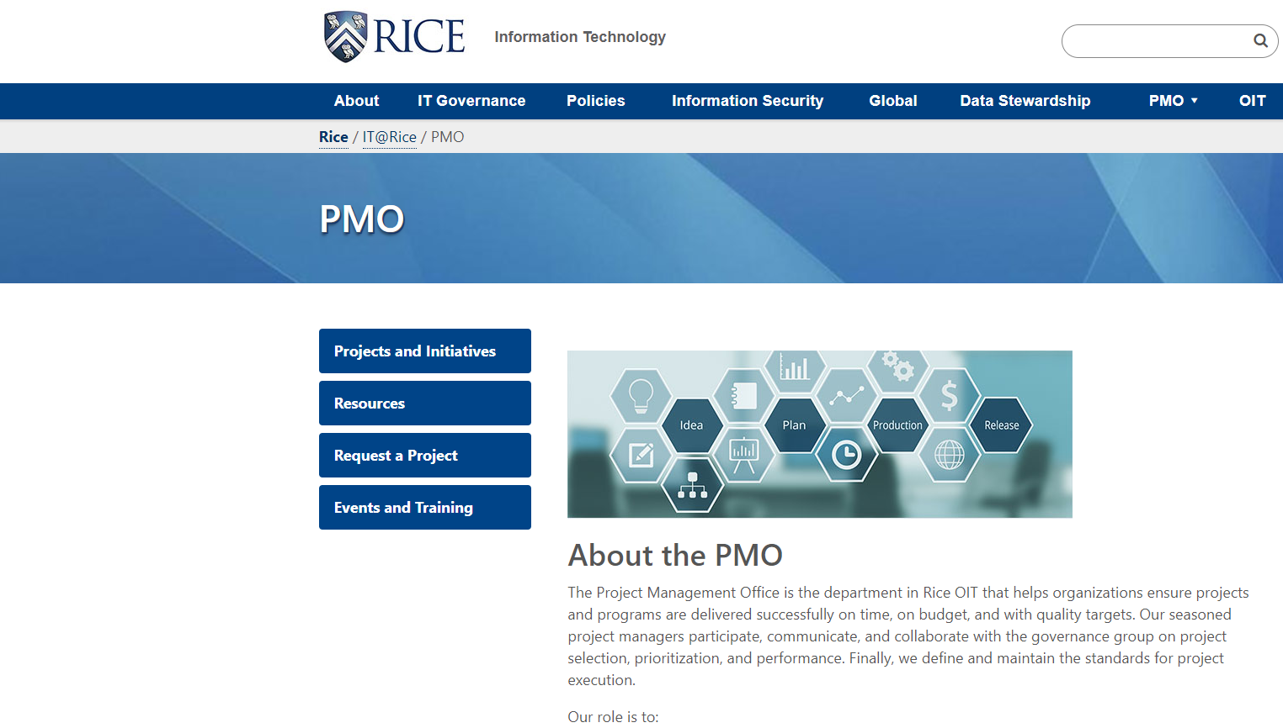
Current Rice tools and techniques?
Here are some, are there others?
OIT – knowledge base, policies, procedures, etc. https://vpit.rice.edu/ https://oit.rice.edu/
OIT – PMO site https://vpit.rice.edu/pmo
OIT Status/Search/Links https://docs.rice.edu/confluence
OIT – individual service team sites
Campus-wide – Box
Campus-wide – Google Drive

Slide 5
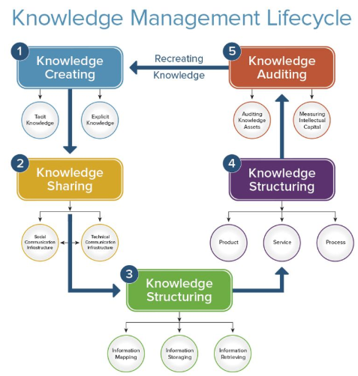
Considerations for KM at Rice?
Testing – test any instruction before you publish
Dissemination – vehicles (e.g. email, social media), timing, repetitions, how do you get important information out most effectively?
Grooming – how often to update, when to deprecate, automation
Distributed environment – where does knowledge live, who owns it, how to find it, avoid duplication?
Projects – lessons learned
Accessibility – headings, alternative text for images, closed captions for videos, screen location for instructions, texture for graphs
Other thoughts on how we could improve?

