Slide 1
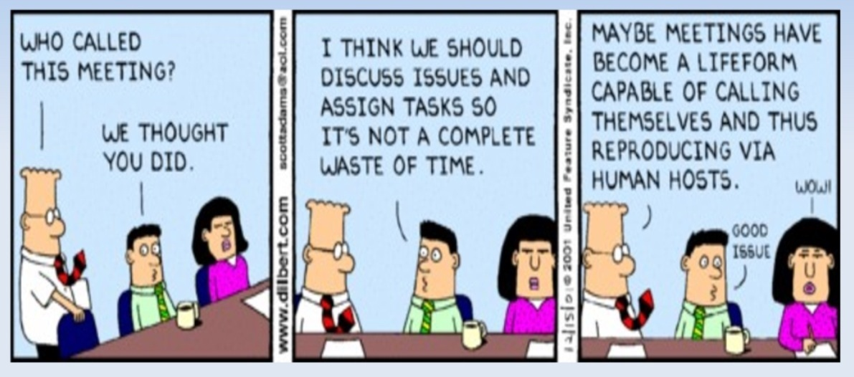
Effective Communication: Meetings
Presented by Sheila Luttrell,
as part of the OIT PMO
“Community of Practice”
brown-bag lunch series
Notes:
THIS is NOT a meeting - This session is intended to create awareness of our own behaviors, and to help us all manage our time (and others’ time) more efficiently.
I APPRECIATE you spending your lunch hour here, and making the effort to gain some practical knowledge that you can put to use right away!
Who wants to spend MORE time in meetings?
Who here has enough time to get all of their work done before going home each day?

Slide 2
What are your meeting “pet peeves”?
Notes:
Late start
“Spilling over” into the hallway to carry on additional discussion that’s not documented
No agenda

Slide 3
Feeling Overwhelmed
45%
Daydreaming
91%
Sleeping
39%
What are people really doing in meetings?
Other Work
73%
Complaining
47%
Notes:
From a study by Wolf Management Consultants (2012)
Ask the meeting participants “why?” people are doing these things?

Slide 4
How much do ineffective meetings cost?
An estimated $37 BILLION dollars per year in the U.S.
The average manager attends 61 meetings per month
Employees report 50% of all meeting time is wasted
Average of 31 hours per month lost by professionals in unproductive meetings
Notes:
Half of the countries in the world have a smaller GDP than $37 billion dollars
Do you agree or disagree with these numbers?
Assume $40/hour average – Typical meeting has, say 10 people. That’s $400 per hour-long meeting!
What is your time WORTH?

Slide 5
How much might ineffective meetings cost Rice OIT?
$40/hour x 31 hours = $1,240 per month loss per employee
$1,240 per month per employee x 150 employees = $186,000 OIT monthly loss due to ineffective meetings
$186,000 per month x 12 months = $2,232,000 OIT annual loss due to ineffective meetings!!!
Notes:
Please note that these are all VERY general assumptions – We are certainly more effective than the national average! However, just imagine how much better we could be…
So you think you need to schedule a meeting…

Slide 6
Do we even NEED a meeting?
What do you (the meeting organizer) want to achieve? What is your goal?
Jot down an agenda – If it’s small or if one person can provide updates/answers, you probably don’t need a meeting!
Notes:
So you think you need to schedule a meeting…

Slide 7
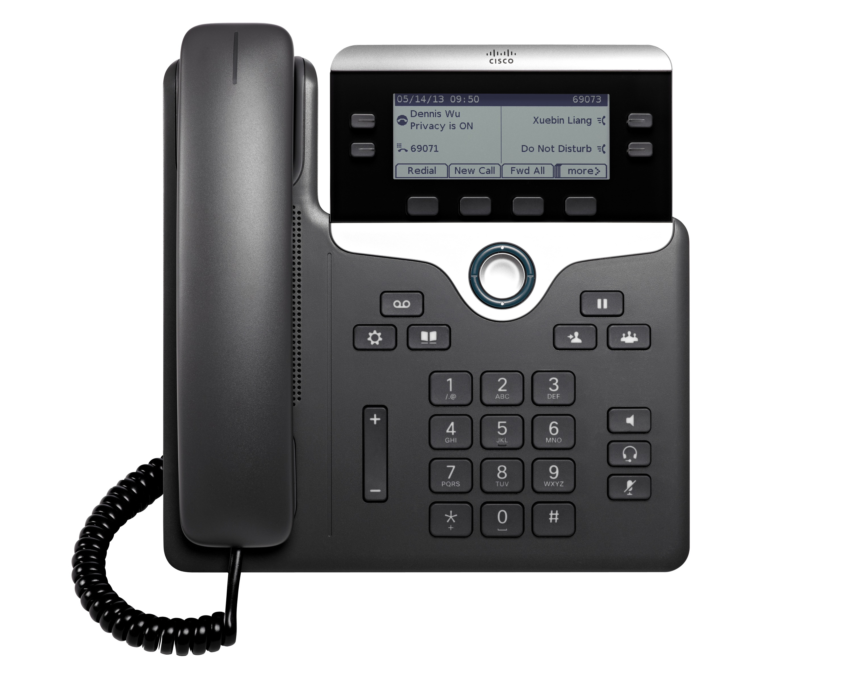
Do we even NEED a meeting? (cont.)
Sometimes the fastest, most effective way to get information is to pick up the phone and call! If the subject is truly sensitive and you need documentation…
Notes:
In the 21st century, we have more communication tools than ever before – But we are LESS likely to engage directly with people in-person or over the phone. WHY?
You’d rather send an email? WHY? How many unread emails are in your inbox? Do YOU want more emails?
Afraid to interrupt?

Slide 8
Do we even NEED a meeting? (cont.)
An email may suffice, as long as it is specific and directed.
If you plan to CC more than one person, “reply-all” messages may get out of control… In this case you probably DO need a meeting!
Notes:
Share example of contractor daily summary report – Long, out-of-order, unclear what they needed.
INSTEAD, don’t be afraid to say “I need xyz from you by 123 day. Is that possible?”

Slide 9
How to lead an effective meeting
Prepare a clear agenda, include it in the meeting invitation
“The purpose of this meeting…”
Desired output – Does a specific decision need to be made IN this meeting? State your goal.
Do participants need to read something before the meeting?
Do participants need to be prepared to share any materials or information?
List agenda topics as questions, to keep participants focused on decision-making
“Decide ahead of time what you need a decision on and practice wording it until it’s clear and succinct.” – Shawn Rhodes, Dallas Business Journal
Notes:
Prepare a clear agenda, include in the meeting invitation – Make sure participants understand the GOAL of the meeting
It is as important for you as it is for the meeting participants

Slide 10
How to lead an effective meeting
Invite only those who can contribute. Then ensure that those people understand why they’re invited and how you’d like them to participate.
BONUS! Fewer attendees = easier to schedule
Notes:
Invite as few people as possible – Decision-makers, those that can provide input, those that are assigned tasks – Also makes scheduling easier
Discuss Steve Jobs kicking people out of meetings if they didn’t have anything to contribute

Slide 11
How to lead an effective meeting
Keep meetings as brief as possible
“The default length of a meeting or call… should be 20 minutes; anything longer should be an exception… Even if you’re just moving from 30-minute meetings to 20-minute meetings, you can fit in 4-6 more meetings, calls, or appointments in a day.” - Ryan Delk, Gumroad (an E-Commerce and digital distribution company)
TED Talks are limited to 18 minutes
No matter how famous, wealthy, or influential, no one is allowed to speak for more than 18 minutes on a TED stage.
Forces people to be disciplined in conveying their point
Notes:
Keep meetings as brief as possible – Schedule 45 or 50 minutes (30 minutes if possible)
Famous short talks:
John F. Kennedy inspired a nation to look to the stars in 15 minutes
Steve Jobs gave one of the most popular commencement addresses of our time at Stanford University, and he did it in 15 minutes
Dr. Martin Luther King shared his dream of racial equality in 17 minutes
Lead in to the ideal gas law, stating that a gas expands to fit the volume allotted

Slide 12
Parkinson’s Law:
“Work expands so as to fill the time available for its completion…”
Cyril Northcote Parkinson –
Parkinson's Law: The Pursuit of Progress (London, John Murray, 1958)
Notes:
Likely a reference to the ideal gas law, stating that a gas expands to fit the volume allotted
So to help you save just a little bit of time…

Slide 13
PRO TIP: Google Calendar Event Settings – “Speedy Meetings”

Slide 14
How to lead an effective meeting
Start on-time
Be familiar with any technology you will be using (projector, web/video conferencing app, podium, etc.)
Open the conference bridge just before meeting start
Begin discussion promptly at meeting start time
End on-time (or sooner)
Wrap up and leave the meeting space promptly, allowing the next meeting leader time to set-up and prepare
Notes:
Start and end on-time – RESPECT others’ time. Allows time for transitions and set-up.

Slide 15
How to lead an effective meeting Keep Meeting Participants Engaged
Bring snacks! (optional, but pretty-much guaranteed to engage people)
Make frequent eye contact
Ask for feedback or experiences
Incorporate some [appropriate] humor
Notes:
Also – move around the room
Briefly discuss “stand-up” meetings
Bonus – On a pretty day, if possible, have an outdoor meeting or a “walking meeting”

Slide 16
How to lead an effective meeting
Enable leadership of team-members (literally – ask them to prepare and lead meetings!)
Don’t lecture!
Encourage participants to ask questions and share information
Notes:
Enable leadership of team-members (from Taligens) – Don’t dominate. Encourage conversation.

Slide 17
How to lead an effective meeting
Allow some “open discussion” time
After completing the agenda items, always ask if there are other items that need to be discussed. Are there any questions or concerns about what we discussed?
"Address and resolve disagreements or tensions openly" (from Taligens)
Notes:
Allow some “open discussion” time at the end

Slide 18
How to lead an effective meeting
Spend the last few minutes doing a recap:
Confirm decisions, next steps and action items (with specific owners, and promise dates)
Everyone knows what is expected next!
Notes:
Confirm action items, specific owners, and promise dates

Slide 19
How to lead an effective meeting
Follow-up with electronic copy of meeting notes and/or action items
Documenting and sharing helps with communication and accountability
Notes:
Follow-up with electronic copy of meeting notes and/or action items
Information becomes part of the project’s historical record
Share cautionary note about capturing too much verbatim conversation

Slide 20
How to lead an effective meeting: Summary
Prepare a thoughtful agenda and share it ahead of time
Invite only those who can contribute
Keep meetings as brief as possible
Start on-time, end on-time (or earlier)
Keep participants engaged
Allow time for open discussion
Document minutes and/or action items and share
Notes:
Follow-up with electronic copy of meeting notes and/or action items
Information becomes part of the project’s historical record
Share cautionary note about capturing too much verbatim conversation

Slide 21
How to participate effectively in meetings
Eliminate distractions
Be courteous – No sidebar conversations
Stay on-topic, follow the agenda
“Address and resolve disagreements or tensions openly” (from Taligens)
Notes:
You have less control, but…
Eliminate distractions: Silence cell phones before meetings, don’t look at them during meetings. Same for laptops. Close conference room door. Lock up the dog.
Stay on-topic, follow the agenda – Don’t skip ahead (show-off!). Hold concerns for the end of the meeting, if not addressed.
Address and resolve disagreements or tensions openly – Calmly, showing concern – Make sure you understand what is being asked of you, or raise concerns that may affect outcomes.
That’s all that I have to share with you on meetings, but I have a few “bonus” communication tips and tools!

Slide 22
Additional Communication Tools and Ideas
Share weekly project status updates (email, project blog site, BaseCamp “discussion”)
Daily Scrum – 15’ Stand-Up Meeting to Discuss:
What we accomplished yesterday
What we are working on today
Any roadblocks
To engage larger audiences or to provide an anonymous channel for instant feedback, use Poll Everywhere (also see Rice KB article 84918)

Slide 23
Additional Communication Tools and Ideas
Create a project org chart
Create a project charter – Include project-specific definitions to ensure common understanding
Create and share a Google Calendar for your project, include milestone dates (keep it updated!)
Notes:
Create a project org chart to recognize team members, clarify roles
Create a project charter – Include project specific definitions to ensure common understanding across teams (e.g. define “system” or “wireless”)
THAT’S ALL, FOLKS!!!

Slide 24
Questions? Feedback?
Presented by Sheila Luttrell,
as part of the OIT PMO
“Community of Practice”
brown-bag lunch series

Slide 25
Thank you!
Presented by Sheila Luttrell,
as part of the OIT PMO
“Community of Practice”
brown-bag lunch series

Slide 26
Sources and Reference Links
Source: | Description:
CBS News | How much do useless meetings cost?
Wolf Motivation | The expense of ineffective meetings
LinkedIn Pulse | The science behind TED’s 18-minute rule
Dallas Business Journal | How to run a meeting like the Secretary of Defense
Fast Company | 9 science-backed methods for more productive meetings
CIO | 15 ways to make meetings more productive
Buffer | 9 science-backed methods for a happier, more productive meeting
Forbes | Meeting hacks from Google, Virgin and Facebook
Business Insider | 3 ways Steve Jobs made meetings insanely productive
Key Organization | Time management statistics
Atlassian | You waste a lot of time at work

Slide 27
“The Expert”

